Slide 1

Dissertation – Week 4
University of Oxford – OMMS
Kim López Güell

Slide 2
What I did over Christmas
Finished my research proposal, as well as collected all intervention dates and data sources
Finished reading Covid by numbers, Spiegelhalter (2021)
Started analysis: negative binomial segmented regression on
  Cases, deaths, hospital admissions, vaccines
  Germany, Denmark, France
  Raw and 7-day smoothed data
Did some summary tables and plots for all the models computed

Slide 3
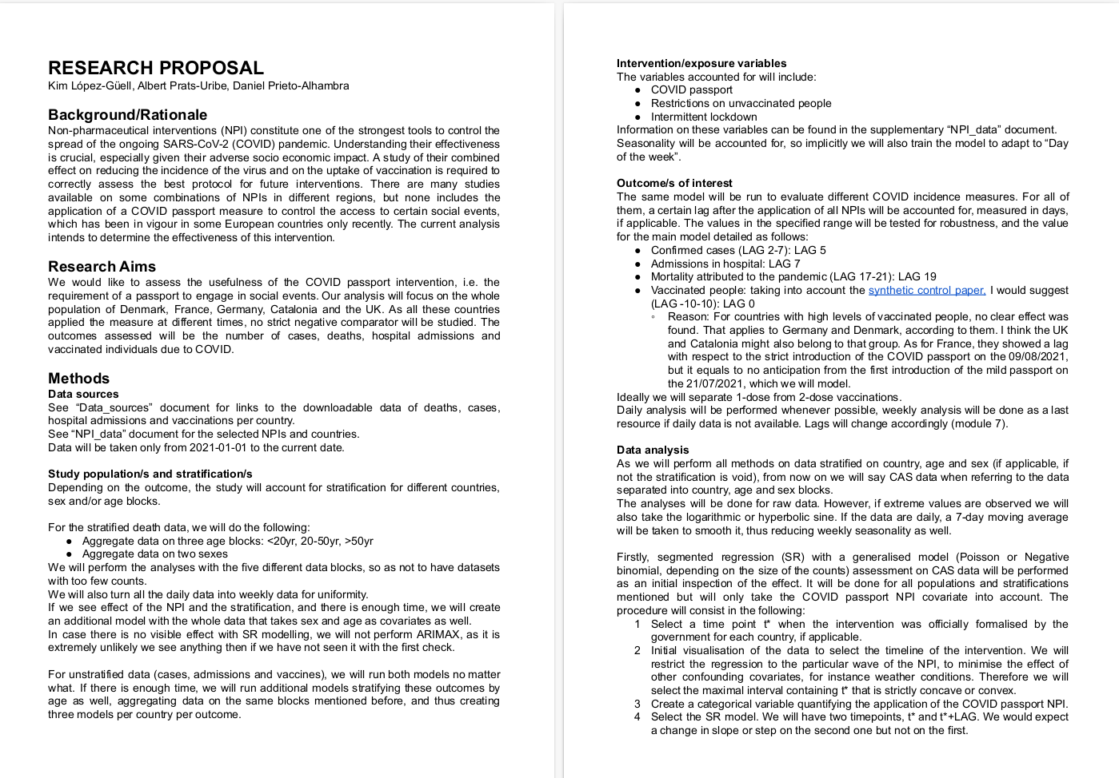
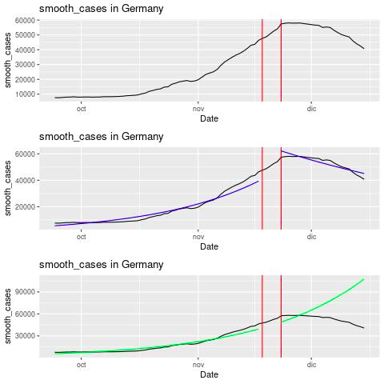
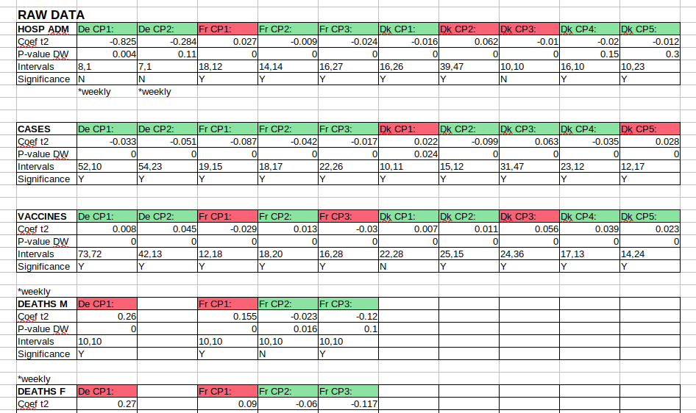
What I did over Christmas
Top left: Research proposal document
Bottom left: summary of SR models
Bottom right: Example of plot (Germany, smoothed cases)

Slide 4
What I will do next week
Include robust errors in all SR models
Create an intervention information table
Start ARIMA modelling for the current outcome/country pairs
Start to write the first chapters of the Dissertation (introduction, general structure, data curation, segmented regression method)

